Slide 1
How Fast Can Your Model Composition Run in Serverless Inference?
Fog Dong @ BentoML & Wenbo Qi @ Antgroup

Slide 2
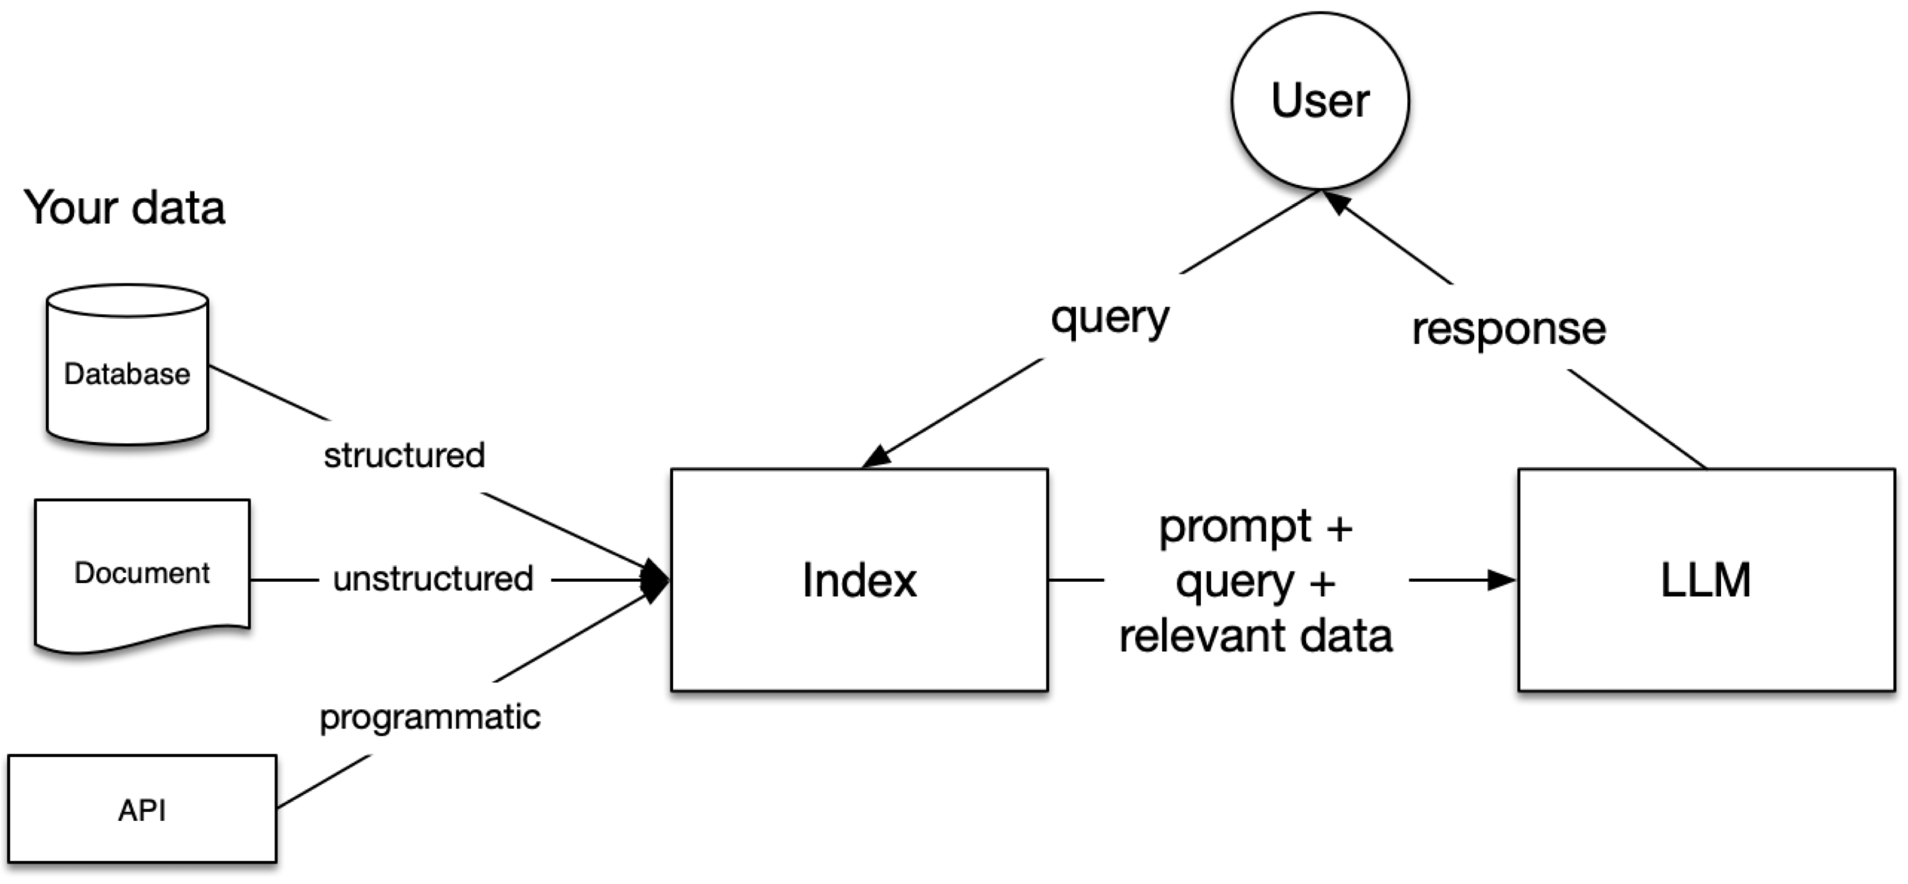
Why Model Composition?
Typical AI Apps need more than one model: RAG example

Slide 3
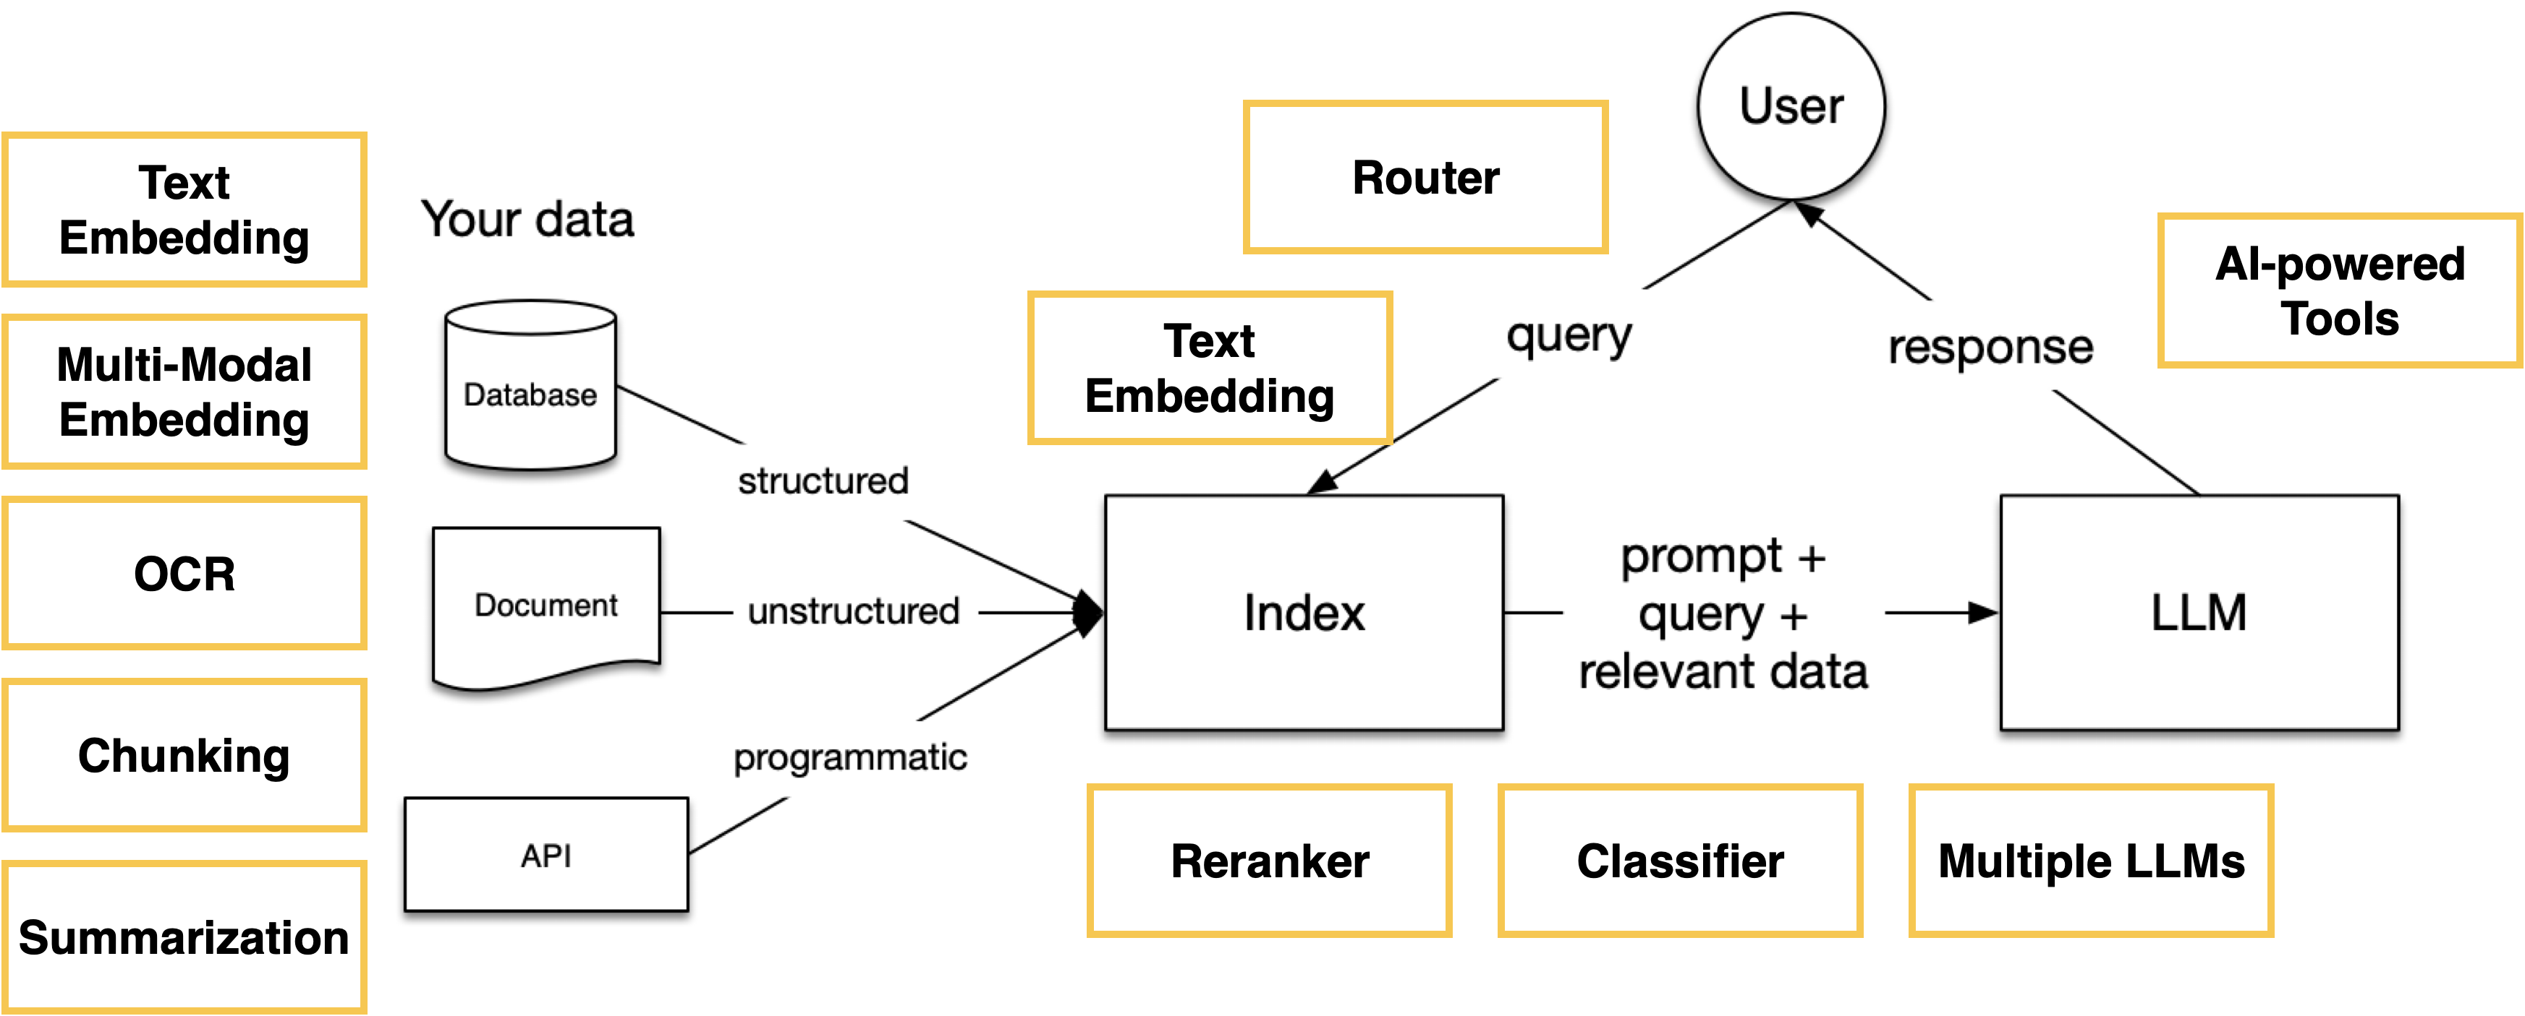
AI Models in a RAG System

Slide 4
Why Serverless?
Cost Efficiency
- Pay only for actual compute time used - No idle resource costs
Auto-scaling
- Seamless handling of varying workloads
- Instant scale-up/down based on demand
Flexibility and Portability
- Easy to deploy across different environments - Less infrastructure management

Slide 5
Build & Scale Compound AI System
Model Inference
- batching
- quantization
- attention optimizations
- tensor/pipeline parallelism
Application Code
Compute Infrastructure
- business logic
- inference code
- batching/scaling customization
- model composition
- autoscaling
- fast cold-start
- deployment management
- multi-model orchestration
- resource & cost management

Slide 6
Application Code
Requirements for Compound AI Apps:
Standardized Interfaces and Communication Protocols: Unified APIs and data formats for seamless inter-model communication, regardless of individual scaling. Ensures compatibility and effective collaboration across different scaling levels.
Independently Scalable Model Architecture: Each model can scale horizontally or vertically independently. Includes decoupled definitions, deployments, and resource allocations. Allows dynamic resource adjustment based on individual model needs without affecting others.
Distributed State Management and Data Flow Orchestration: Mechanisms for managing and synchronizing states across differently scaled instances. Defines efficient data flows between models at various scales, maintaining consistency and integrity during scaling operations.

Slide 7
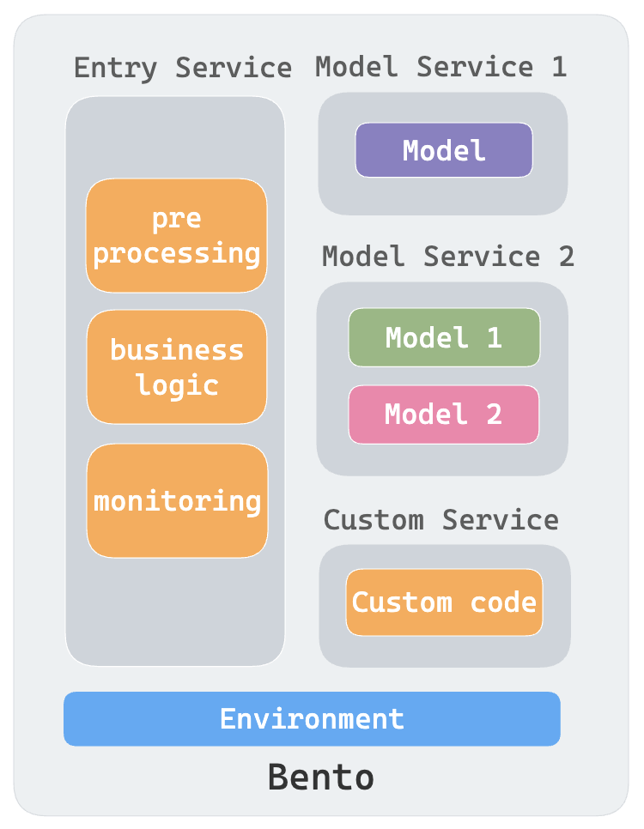
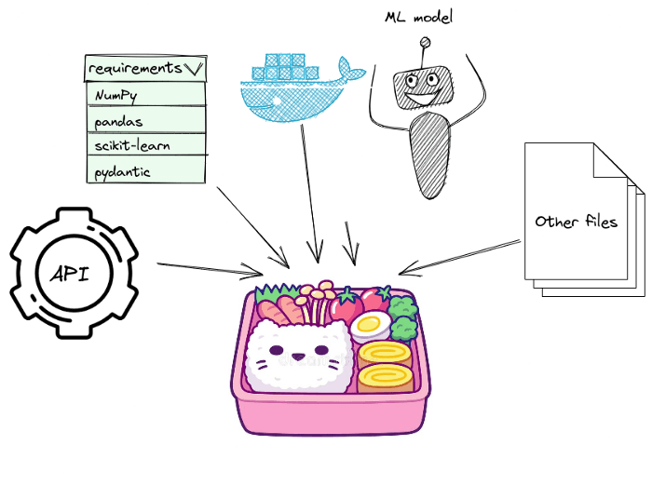
Application Code
Model & Code
Build
Bento 🍱
source
https://github.com/bentoml/bentoml
Build models like microservices

Slide 8


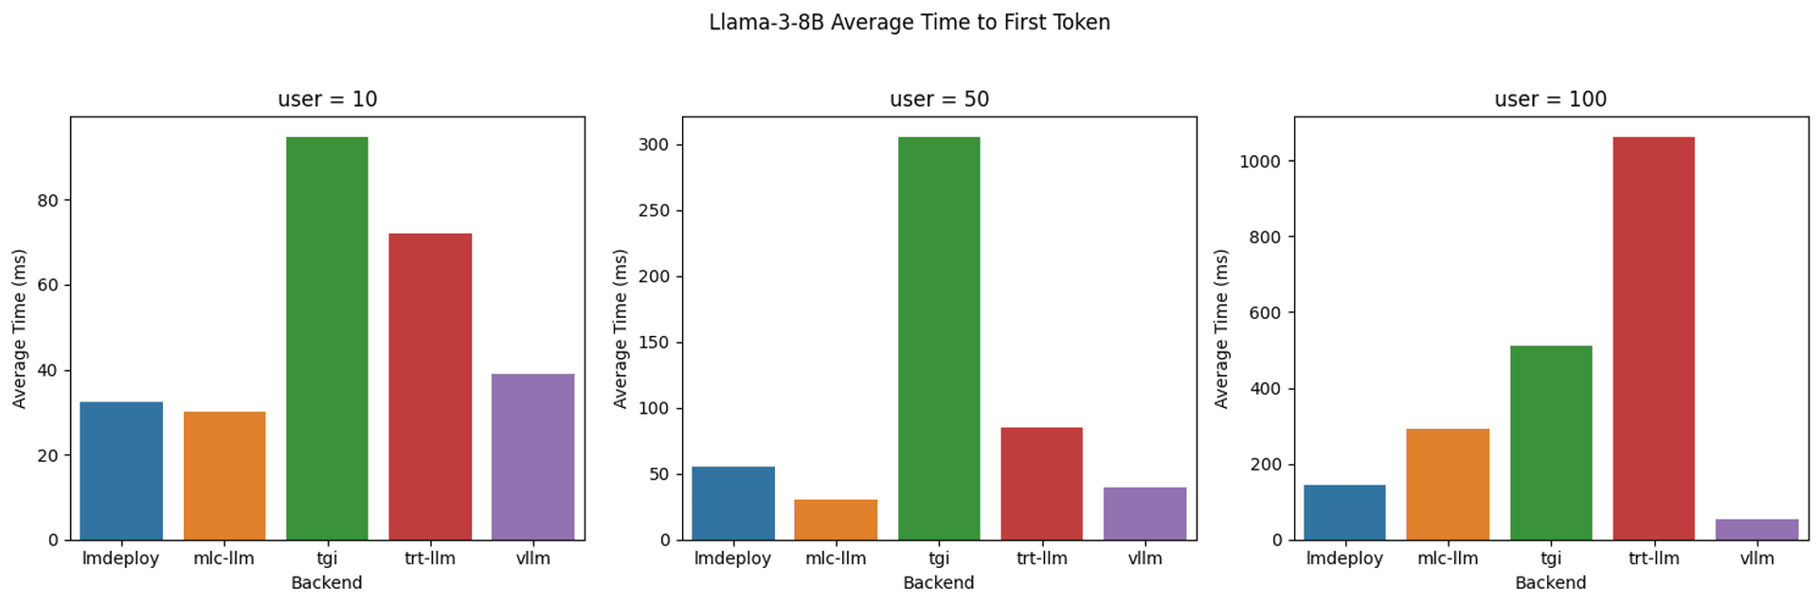
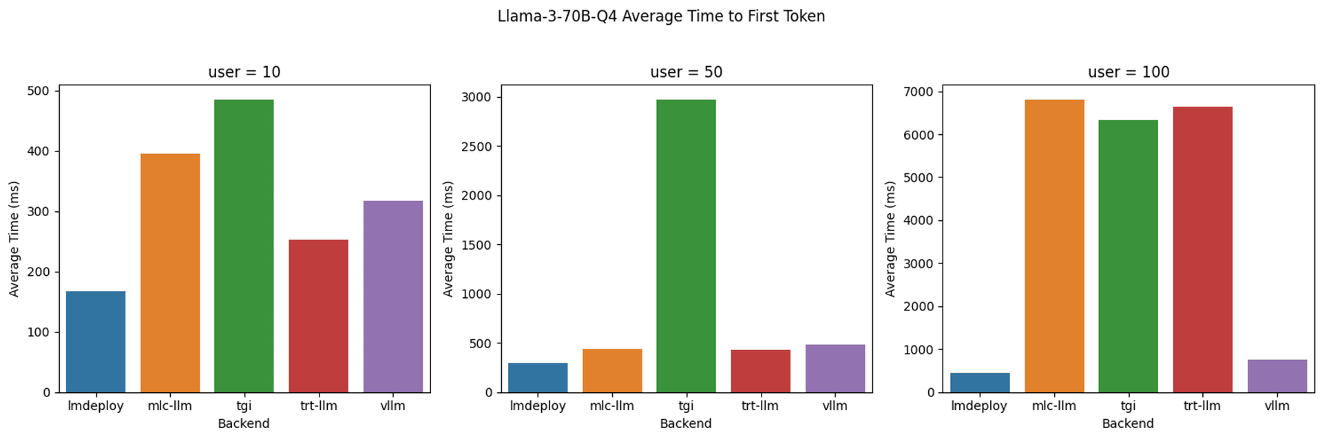
Model Inference: Benchmarking
Inference Backends: vLLM, LMDeploy, MLC-LLM, TensorRT-LLM, and TGI
Models: Llama 3 8B and 70B quantized
Best time-to-first-token (TTFT) among all inference backends, concurrent user levels, and model parameter sizes.
Extensive model architecture and hardware support.
Easy to integrate with under 50 lines of Python code. Comprehensive documentation and examples.
Robust open source community.

Slide 9
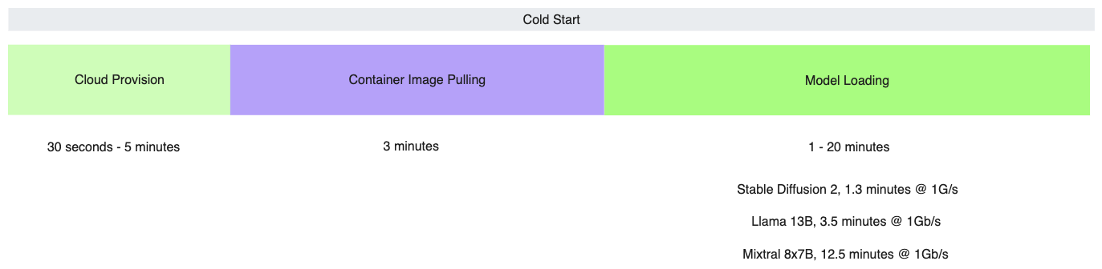
Compute Infrastructure: Cold Start
3~10 minutes
Total: 5 ~ 30 minutes for a single model

Slide 10
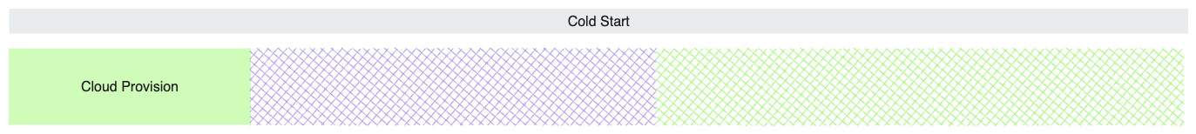
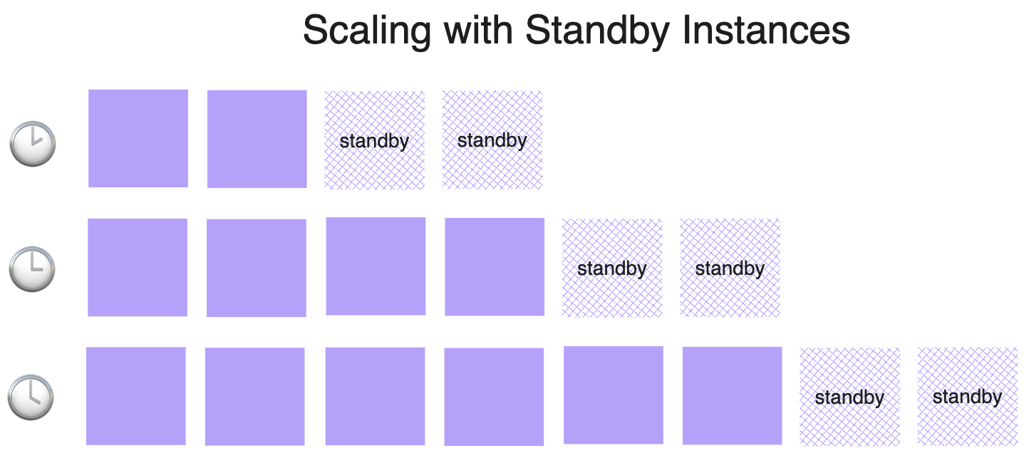
Cloud Provisioning
Heterogeneous instance types.
GPU: T4, L4, A10, A100, H100
TPU: generations and topologies
Pre-provisioning for peak traffic is too expensive.
Provision standby instances only for each scaling step.
Multi-tenancy for economies of scale.

Slide 11

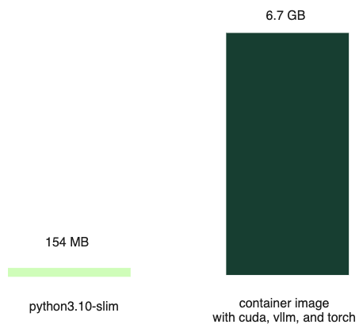
Container Image Pulling
Pull from registry is slow.
Significant % of the files are unused.
Optimize container image (dead end).
Index files and pull on-demand.
Peer-to-peer image pull within the cluster.
nvidia: 2.8 GB
torch: 1.4 GB
xformers: 473 MB
vllm: 306 MB
triton: 277 MB

Slide 12
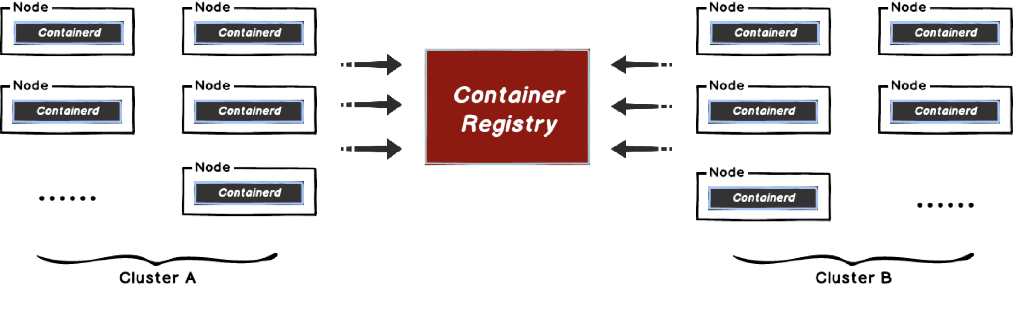
Why use P2P?
When downloading files in large batches, the storage bandwidth can easily reach the limit.

Slide 13


Why use P2P?
How to solve the problem?
Increase storage bandwidth
P2P eliminates the impact of bandwidth limitations
Reduce download size

Slide 14
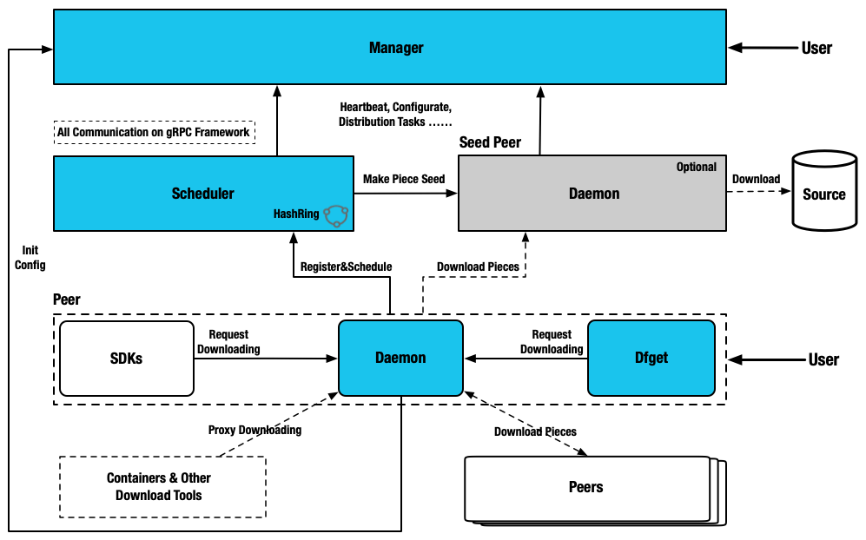
What is Dragonfly?
What is Dragonfly？
Provide efficient, stable and secure file distribution and image acceleration based on p2p technology to be the best practice and standard solution in cloud native architectures.
Manager manages cluster relationships, dynamic configuration and provides a console.
Scheduler schedules a set of parent nodes for the download node.
Peer provides upload and download capabilities.

Slide 15
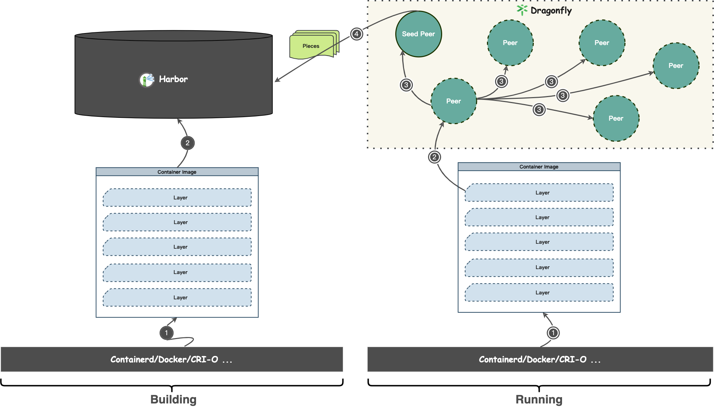
Accelerate Pulling Container Image

Slide 16
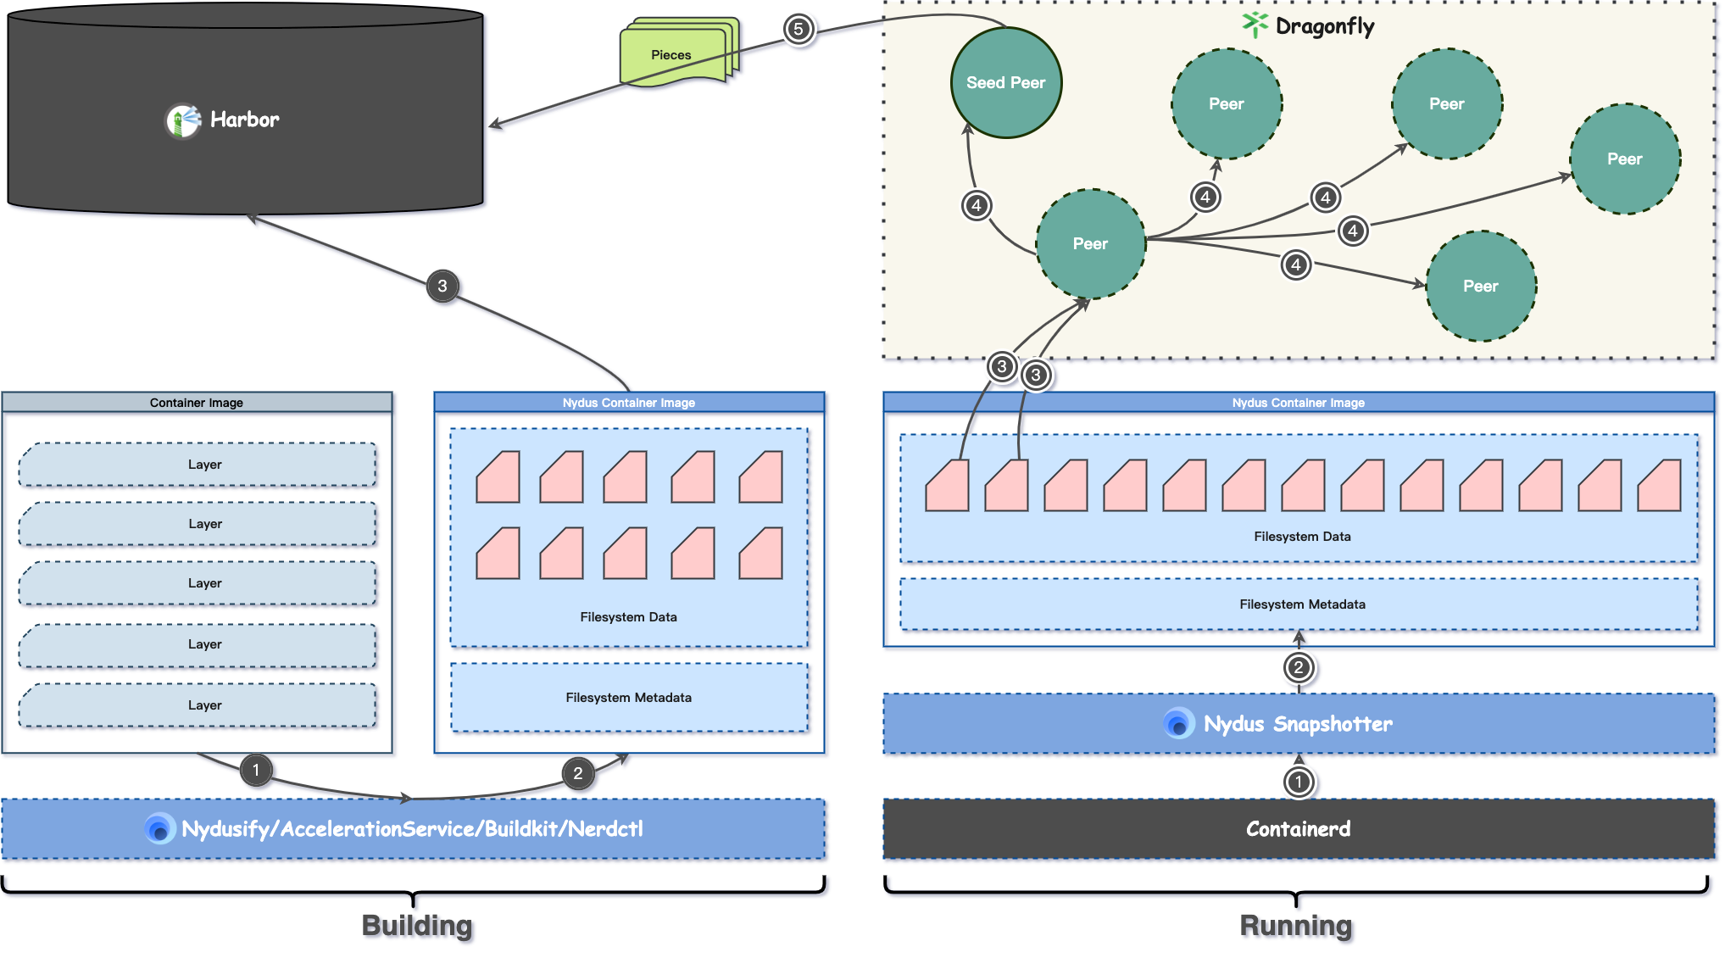
Accelerate Pulling Container Image

Slide 17
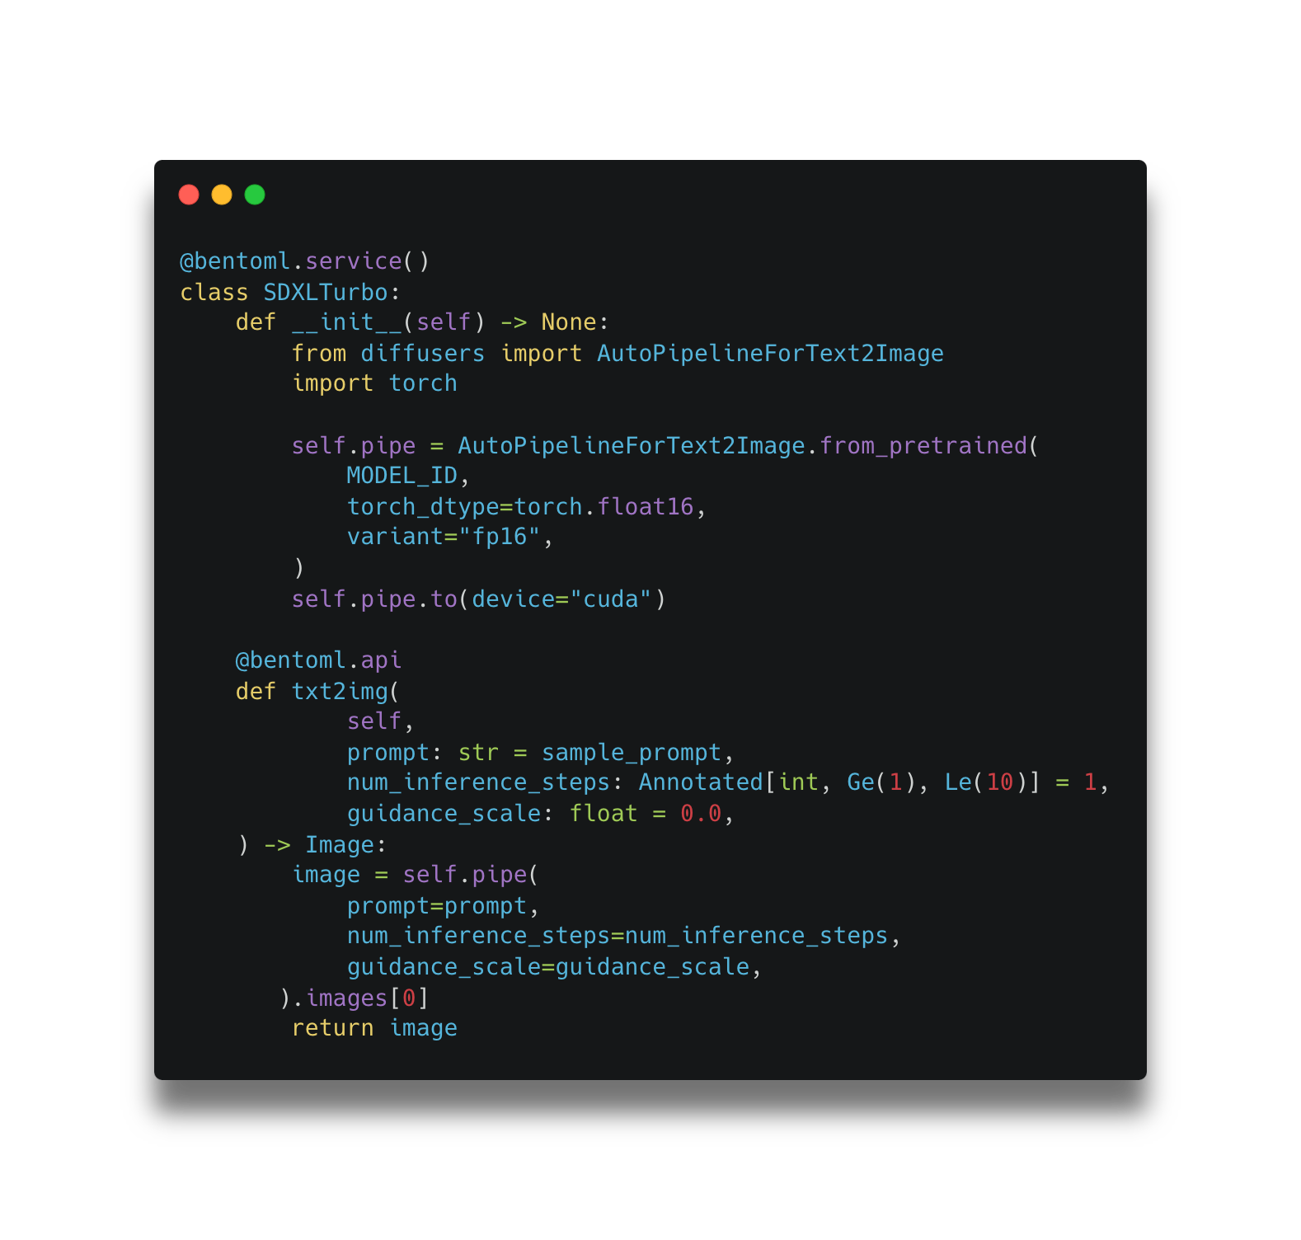
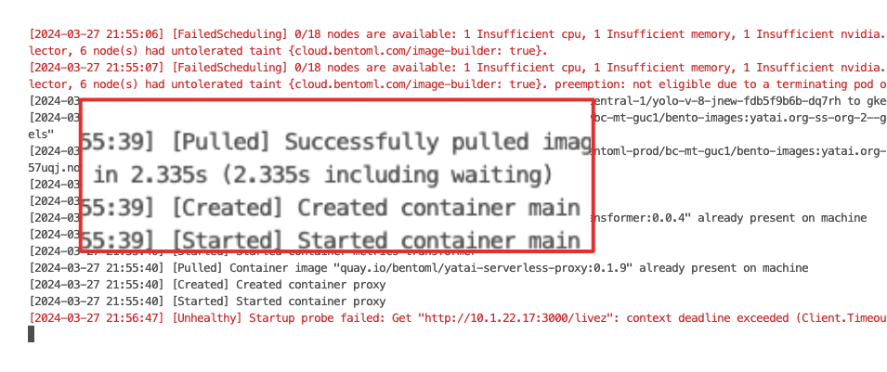
Container Image Pulling

Slide 18

Model Loading
Model Loading Approaches: Pros & Cons
Package model in image Pros: Simple deployment Cons: Slow unpacking, resource waste
OCI image mounting Pros: Efficient sharing Cons: Download speed bottleneck
Runtime download(e.g. Huggingface) Pros: Flexibility Cons: Potential startup delays
Storage mounting Pros: High throughput, efficient sharing Cons: Setup complexity

Slide 19
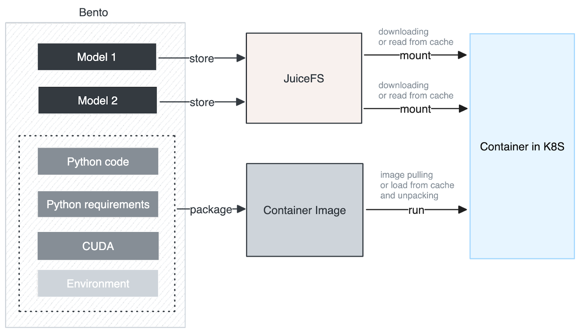
Model Loading

Slide 20
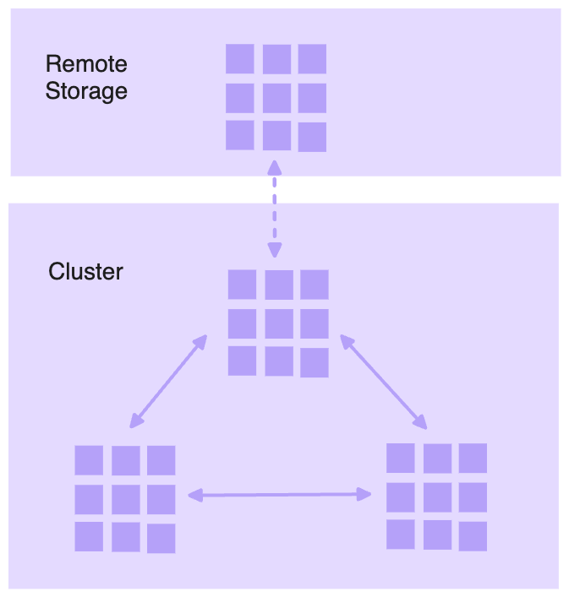
Model Loading
Use distributed storage
In-region network bandwidth
Seed model in distributed file systems
Chunked files and parallel download
Leverage caching
In-cluster peer-to-peer sharing
Local cache

Slide 21
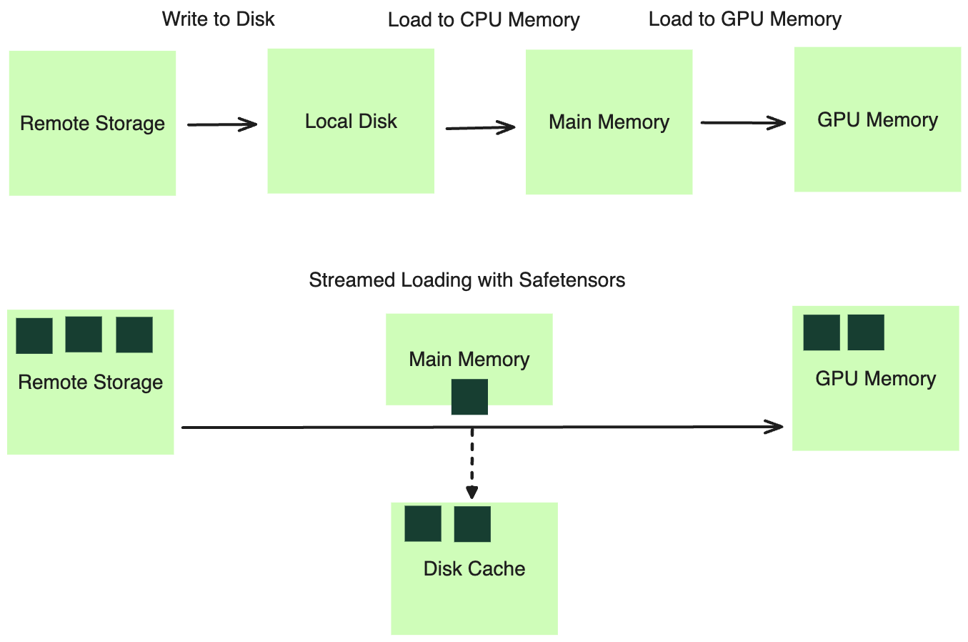
Model Loading

Slide 22
Model Loading
For llama-3 8B, with model preheat:
INFO 08-15 00:24:56 loader.py:326] Deserialized 16.1 GB in 18.49s, 868.7 MB/s
without model preheat (loading from HF directly):
INFO 08-15 00:27:28 loader.py:326] Deserialized 16.1 GB in 38.50s, 417.1 MB/s
Ref: https://github.com/bentoml/BentoML/commit/87b7ccbdc1d4c5143f844f097d9259b25630d234

Slide 23
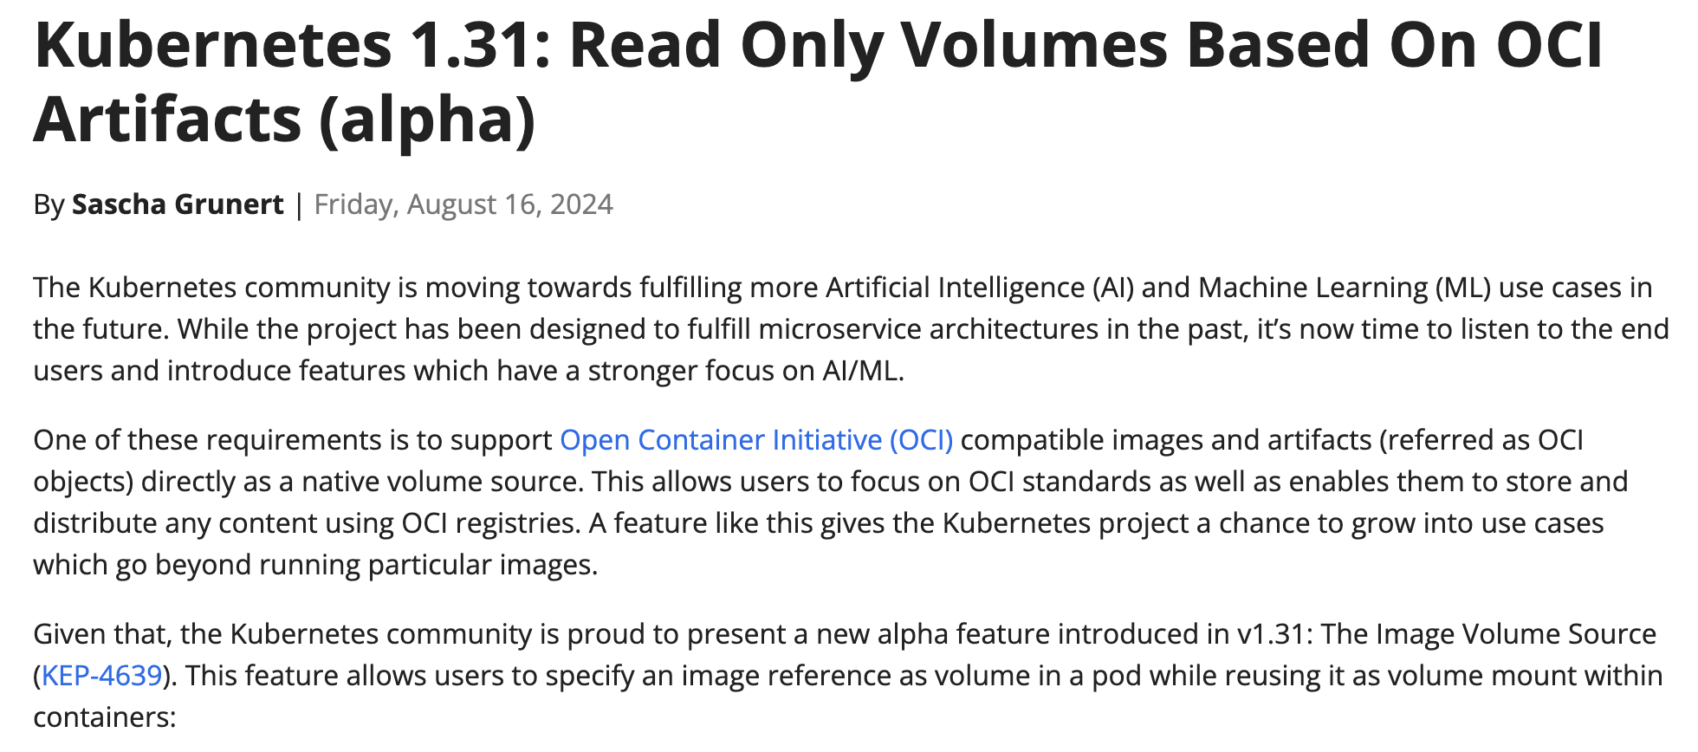
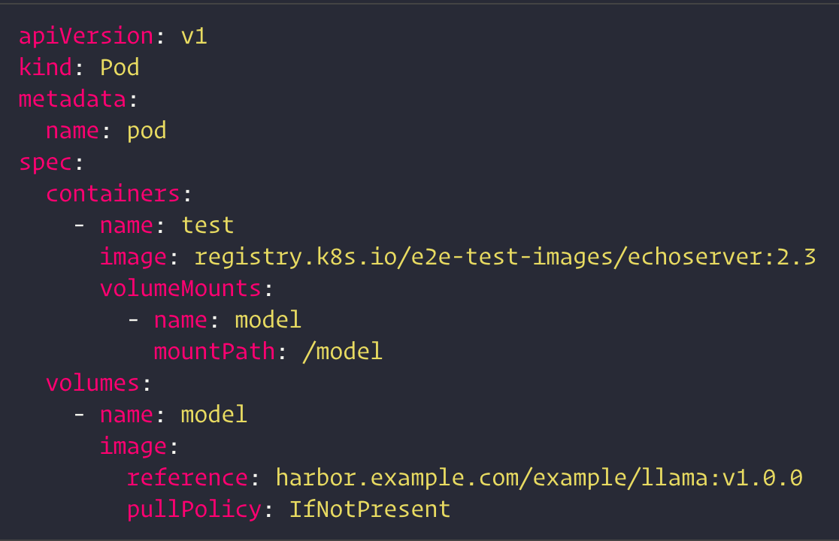
Accelerate Loading Model

Slide 24
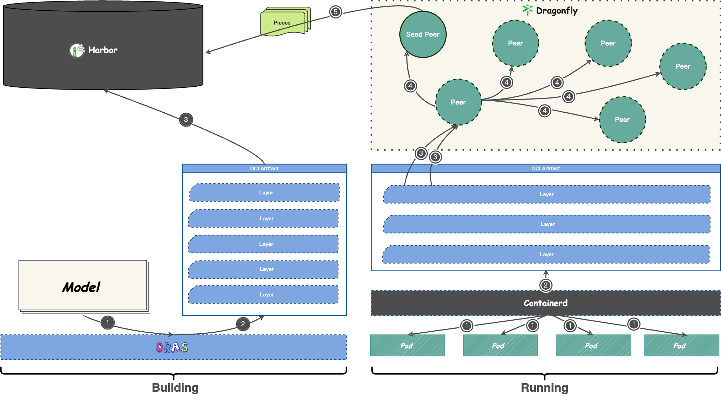
Accelerate Loading Model

Slide 25
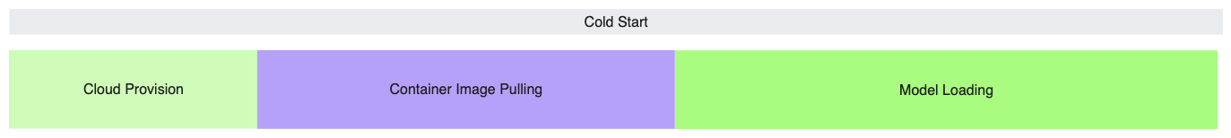
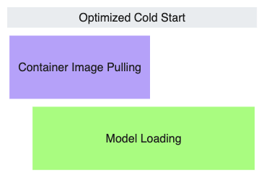
Cold Start
Eliminate cloud provision delay with standby instances.
Faster container image pulling with on-demand and peer-to-peer streaming.
Accelerated model loading time with distributed file systems, peer-to-peer caching, and streamed loading to GPU memory.
Parallelized image pulling and model loading enabled by service framework.

Slide 26


Thanks!
BentoML
Dragonfly
Give us a Star!
Fog Dong @ BentoML & Wenbo Qi @ Antgroup

